Slide 1
Foundations of Modern Software Systems
Module-2
Instructor: Piyush Goel
N.M.A.M. Institute of Technology

Slide 2
Recap - Lecture - 2

Slide 3
Storage: Data Types
Why is it important to understand the Data Types?

Slide 4
Storage: Data Types
Numbers
Integers
Signed
Unsigned
Decimals
Low Precision
High Precision
Characters
Enums
Boolean
Function
Array
Pointer
Reference
Class
Structure
Union
Dictionary
Strings
Tuples
List
Set
Complex Number
Byte
Int
Array
Short
String
Set
List
Question: How would I store a Boolean? How many bytes do I need to store a boolean value?

Slide 5
Questions - 1: Decimals
What is single-precision and double-precision for decimals?
What could be an impact of incorrect precision or round-off?
Watched the movie “Office Space?
Rockets can explode? :))
IEEE-754 - Do Read this.
What type of use-cases need high precision Decimals?

Slide 6
Questions - 2: Strings
How many bytes do I need to store Strings?
How do I store non-Latin or non-English characters?
Character Sets
Unicode
Encodings
Variable Length Character Encodings (UTF-8)
Lang and Locale
Practical Example - Zomato
Ever heard of Mojibake?
How do I sort similar looking characters? (A vs Ä)
Collation

Slide 7
Questions - 3: Time
How do I represent Time?
MySQL has 4 different data-types
Date
Time
DateTime
Timestamp
Year
What about Timezones?

Slide 8
Questions - 4: Binary Objects
How do I store random binary objects?
Music files
Images
PDF files
Homework: Try to store a PDF file or a JPEG Image in a MySQL database.

Slide 9
Data Types: Storage Systems
MySQL - https://dev.mysql.com/doc/refman/8.0/en/data-types.html
MongoDB - https://www.mongodb.com/docs/mongodb-shell/reference/data-types/
SQLite - https://www.sqlite.org/datatype3.html

Slide 10
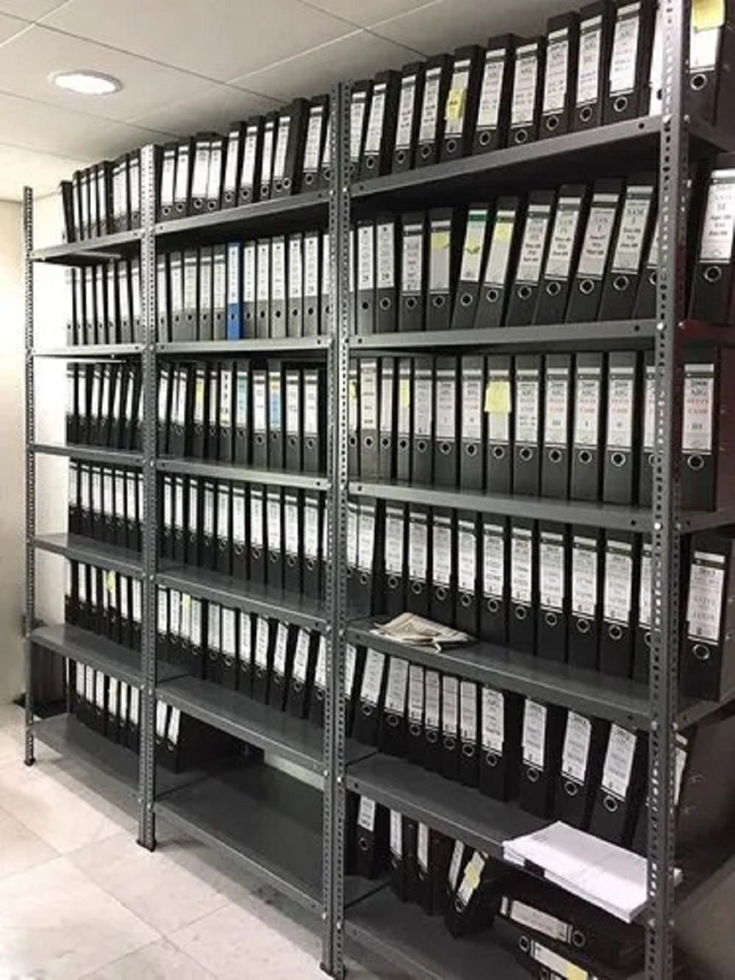
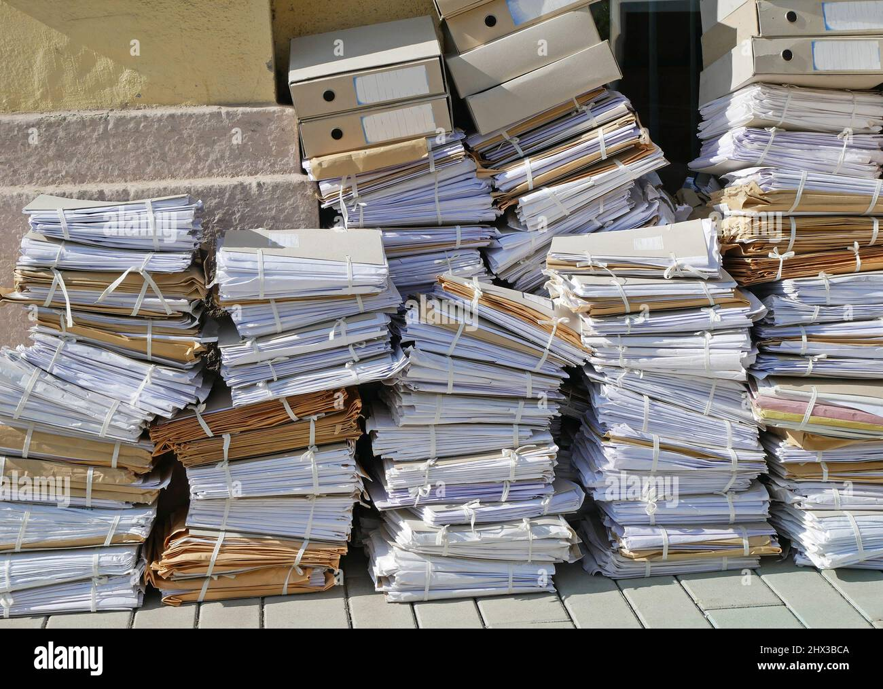
Storage - Fundamentals - File Systems
Why do we need File Systems?

Slide 11
Storage - Fundamentals - File Systems
What if I want a more reliable and high concurrency/throughput from my file system?
Billions of Files - Think about all the photos we click?
Petabytes of Storage - Think about all the movies that have to be stored?
Data Corruption - What if my hard-disk gets corrupted or damaged?
Thousands of Users - Think about concurrency/throughput if everyone in the room
wants to watch a single movie at the same time?

Slide 12
Storage - Fundamentals - File Systems
Distributed File Systems:
Google - Google File System (GFS)
Yahoo - Hadoop Distributed File System (HDFS)
https://www.youtube.com/watch?v=vdkx2xasGlM&ab_channel=Udacity
https://www.youtube.com/watch?v=4Gfl0WuONMY&ab_channel=InfoQ

Slide 13
Storage - Fundamentals
File Systems
Serialisation
Compression
Ad-hoc things.

Slide 14
Storage: Fundamentals - Serialisation
What is Serialisation? Why is it needed?

Slide 15
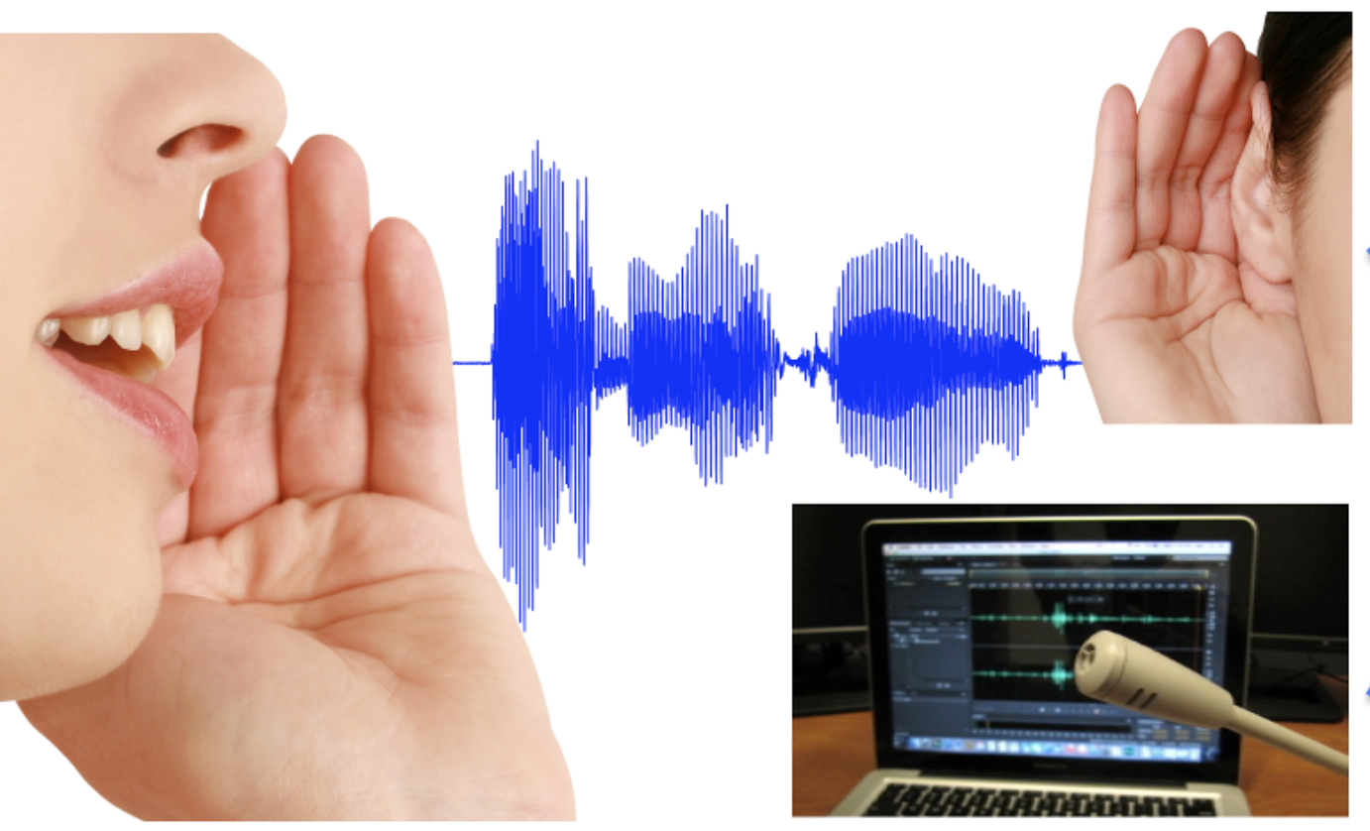
Storage: Fundamentals - Serialisation
How do we comprehend speech? How do you understand when someone is speaking?

Slide 16
Storage: Fundamentals - Serialisation
How are words getting transmitted from the speaker’s mouth to our ears?
How is the meaning of the speaker’s thoughts getting captured into a book?

Slide 17
Storage - Fundamentals - Serialisation
In computing, serialization (or serialisation) is the process of translating a data structure or object state into a format that can be stored (e.g. files in secondary storage devices, data buffers in primary storage devices) or transmitted (e.g. data streams over computer networks) and reconstructed later (possibly in a different computer environment). When the resulting series of bits is reread according to the serialization format, it can be used to create a semantically identical clone of the original object.
https://en.wikipedia.org/wiki/Serialization

Slide 18
Storage - Fundamentals - Serialisation
Serialisation - Deserialisation
Marshalling - Unmarshalling
Encoding - Decoding

Slide 19
Storage - Fundamentals - Serialisation
Different Methods of Serialisation
Human Readable vs Machine Readable
Language Specific vs Language Agnostic
Verbose vs Compact

Slide 20
Storage - Fundamentals - Serialisation
Different Methods of Serialisation
Human Readable
CSV
JSON - Popular in Internet Systems
XML
YAML
Machine Readable
Binary Formats
Thrift (Made by Facebook), ProtoBuf (Made by Google), MsgPack
Binary JSON (BSON used by MongoDB)
Proprietary or Application Specific Formats

Slide 21
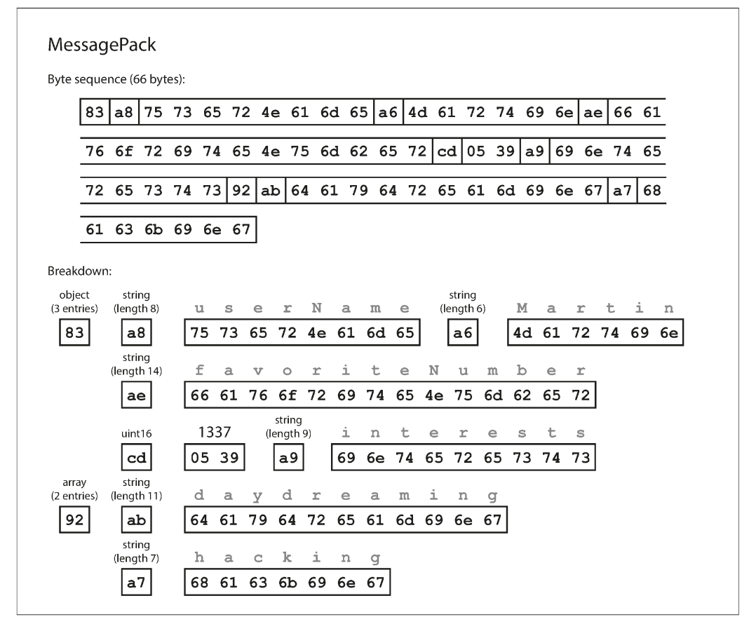
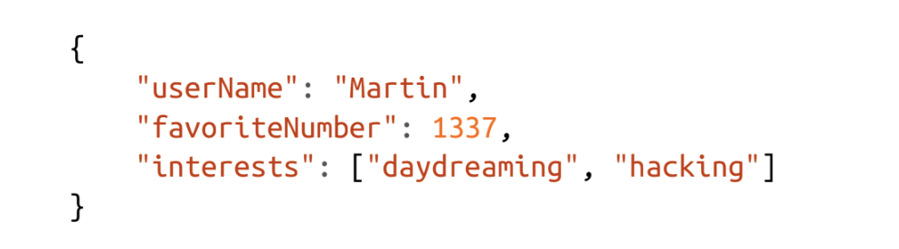

Slide 22
Storage - Fundamentals - Serialisation
Different Methods of Serialisation
Language Specific
Java Serialisation (Serializable keyword)
Python Pickle
Ruby Marshal
Language Agnostic
CSV
JSON
XML

Slide 23
Storage - Fundamentals - Serialisation
Different Methods of Serialisation
Verbose
JSON
XML
Compact
MsgPack
ThriftCompact
Other Binary Protocols

Slide 24
Storage - Fundamentals - Serialisation
Let’s look at some examples.

Slide 25
Storage - Fundamentals - Compression

Slide 26
Storage - Fundamentals - Compression
In information theory, data compression, source coding, or bit-rate reduction is the process of encoding information using fewer bits than the original representation. Any particular compression is either lossy or lossless. Lossless compression reduces bits by identifying and eliminating statistical redundancy. No information is lost in lossless compression. Lossy compression reduces bits by removing unnecessary or less important information. Typically, a device that performs data compression is referred to as an encoder, and one that performs the reversal of the process (decompression) as a decoder.
https://en.wikipedia.org/wiki/Data_compression

Slide 27
Storage - Fundamentals - Compression
Any compression formats that we are using every day?

Slide 28
Storage - Fundamentals - Compression
JPEG
MP3
G-ZIP

Slide 29
Storage - Fundamentals - Compression
JPEG
MP3
G-ZIP
* A lot of Indians have worked on Compression Formats over the years.
https://en.wikipedia.org/wiki/K._R._Rao
https://en.wikipedia.org/wiki/Nasir_Ahmed_(engineer)

Slide 30
Storage - Fundamentals - Compression
Other popular Compression Formats
ZIP
PKZIP
LZIP
Deflate
Snappy

Slide 31
Storage - Fundamentals - Compression
Let’s look at some examples.

Slide 32
Storage - Fundamentals - Compression
Huffman Coding Algorithm?

Slide 33
Questions

